Slide 1

Final Project Style Transfer: An odyssey to anime world
Xinrui Jiang
CSCI S-89 Introduction to Deep Learning
Summer 2022
Harvard Summer School

Slide 2
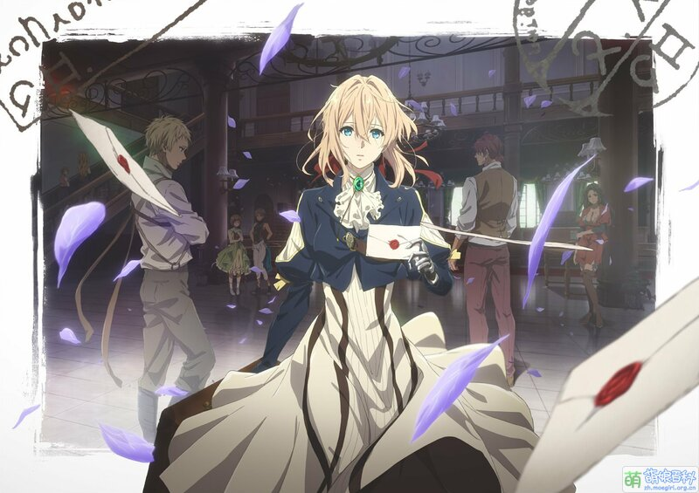
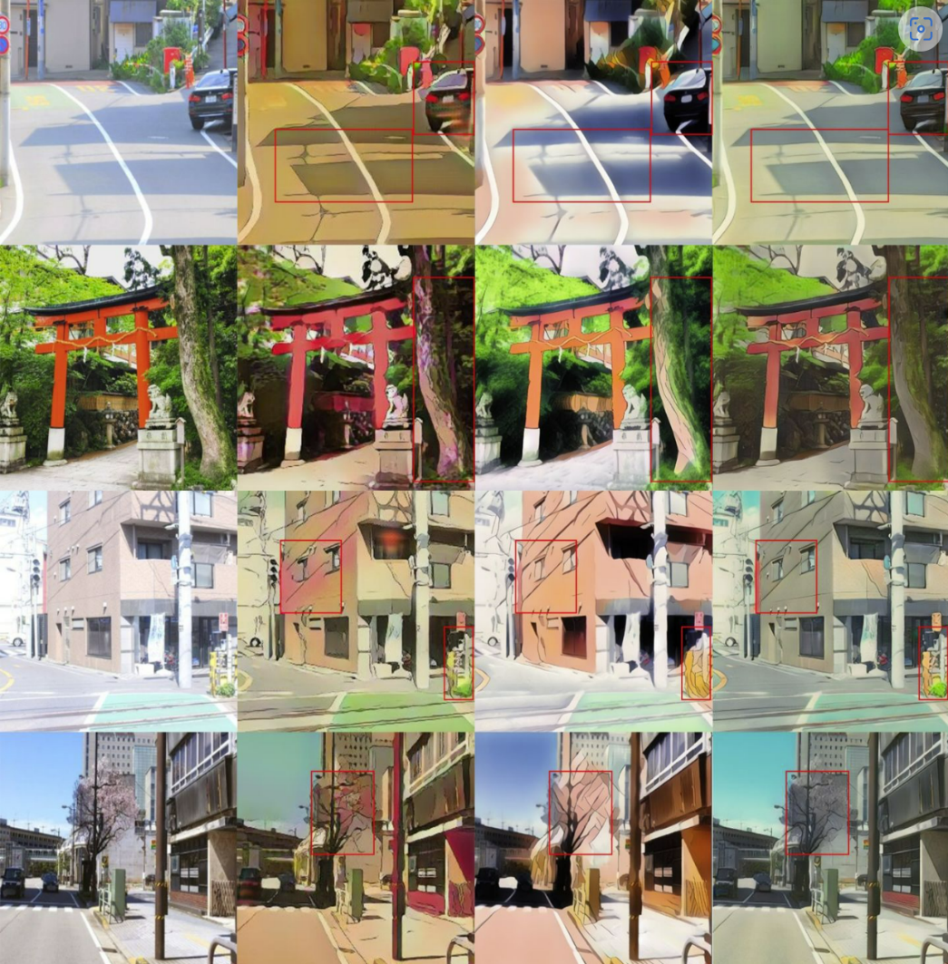
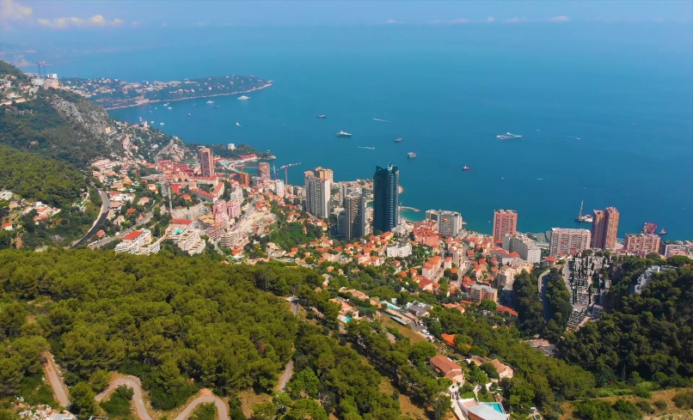
Introduction
how?

Slide 3
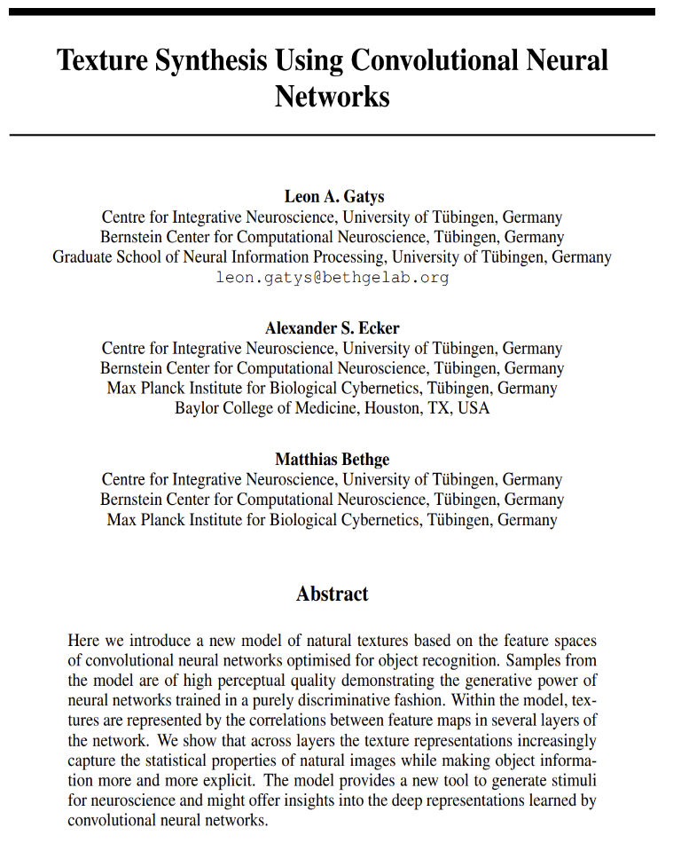
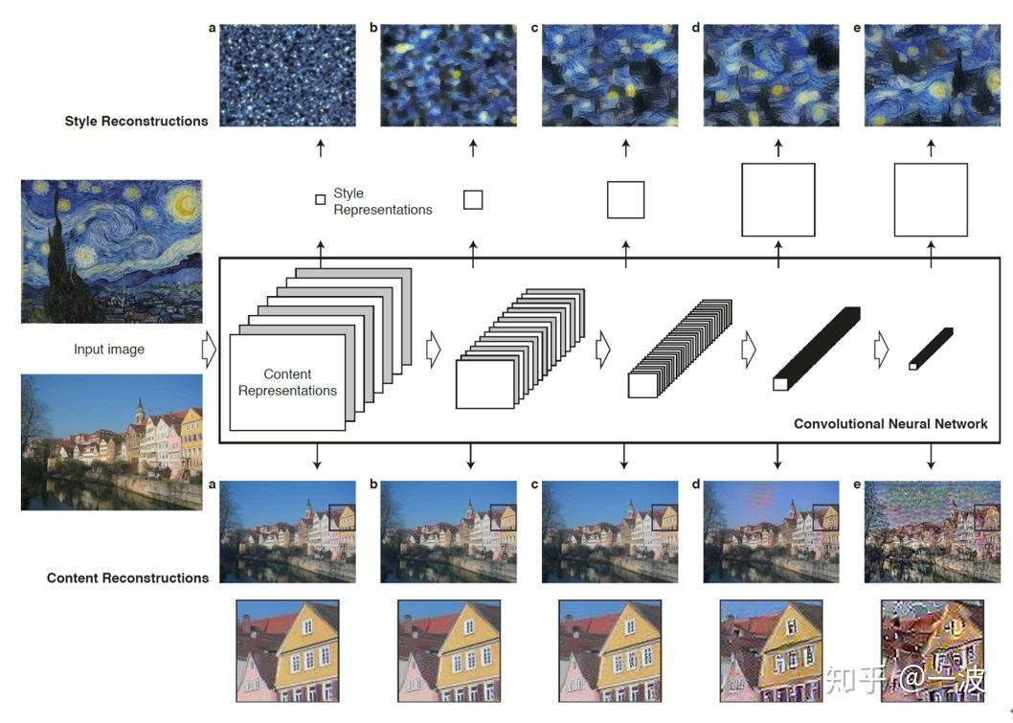
Style Transfer

Slide 4
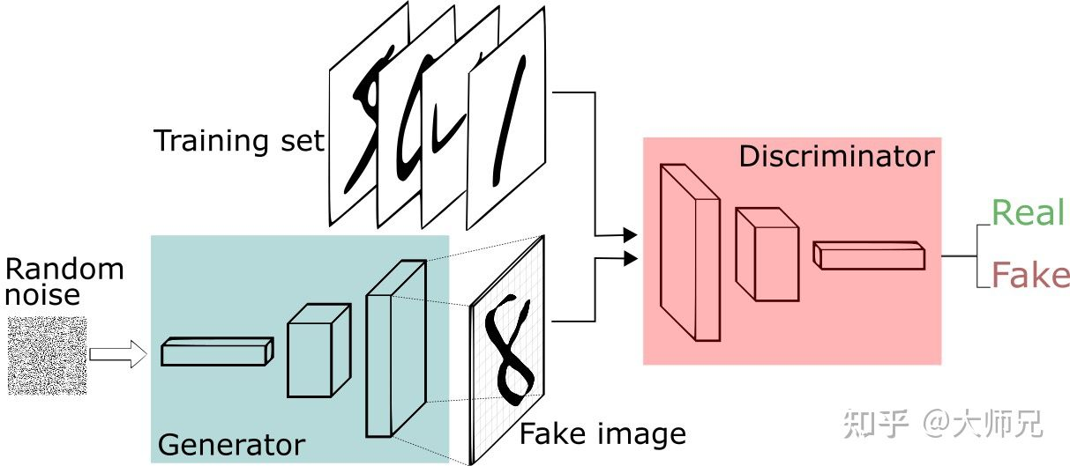

Slide 5
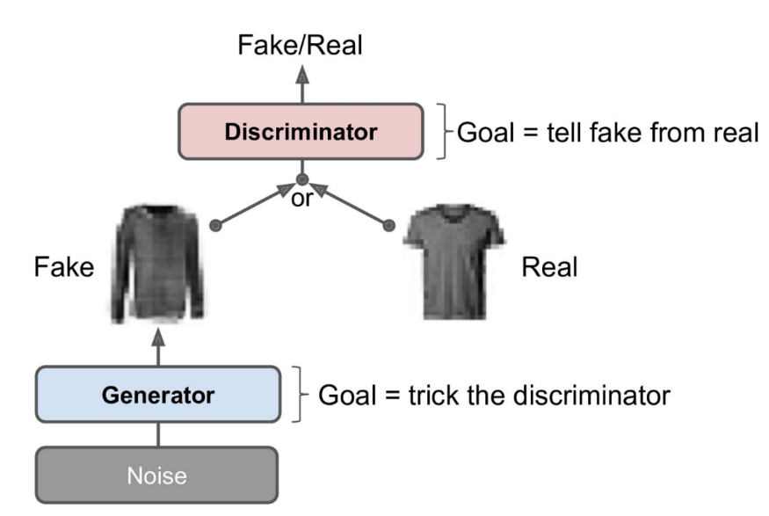
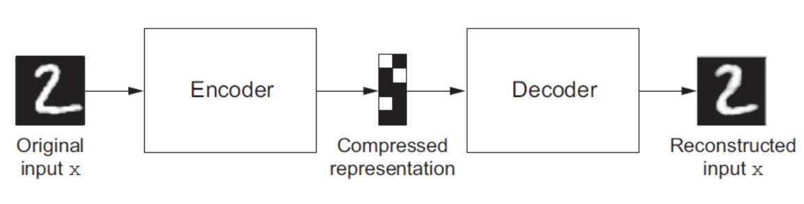
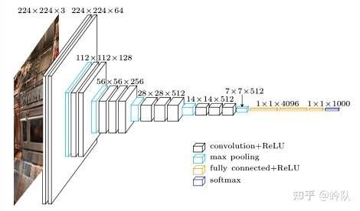
Methodology
GAN
Autoencoder
Transfer learning and VGG19 pretrained model

Slide 6
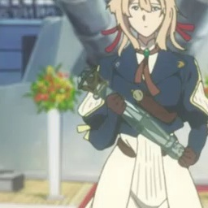
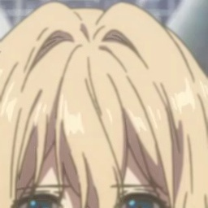
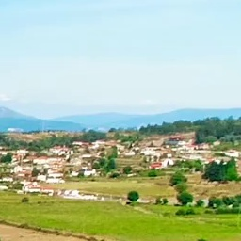
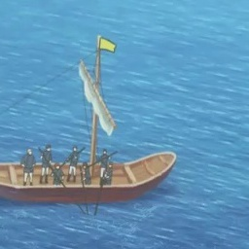
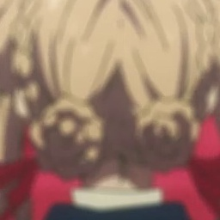
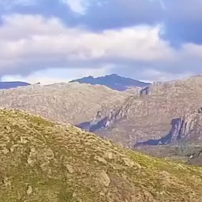
Dataset
Anime
Anime_smoothed
Natural scenery

Slide 7
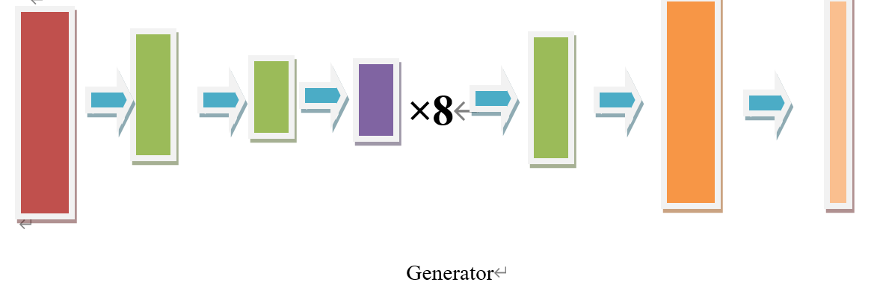
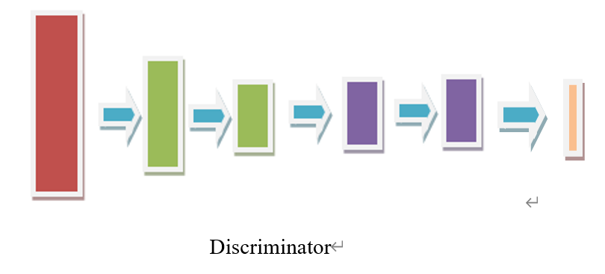

Slide 8
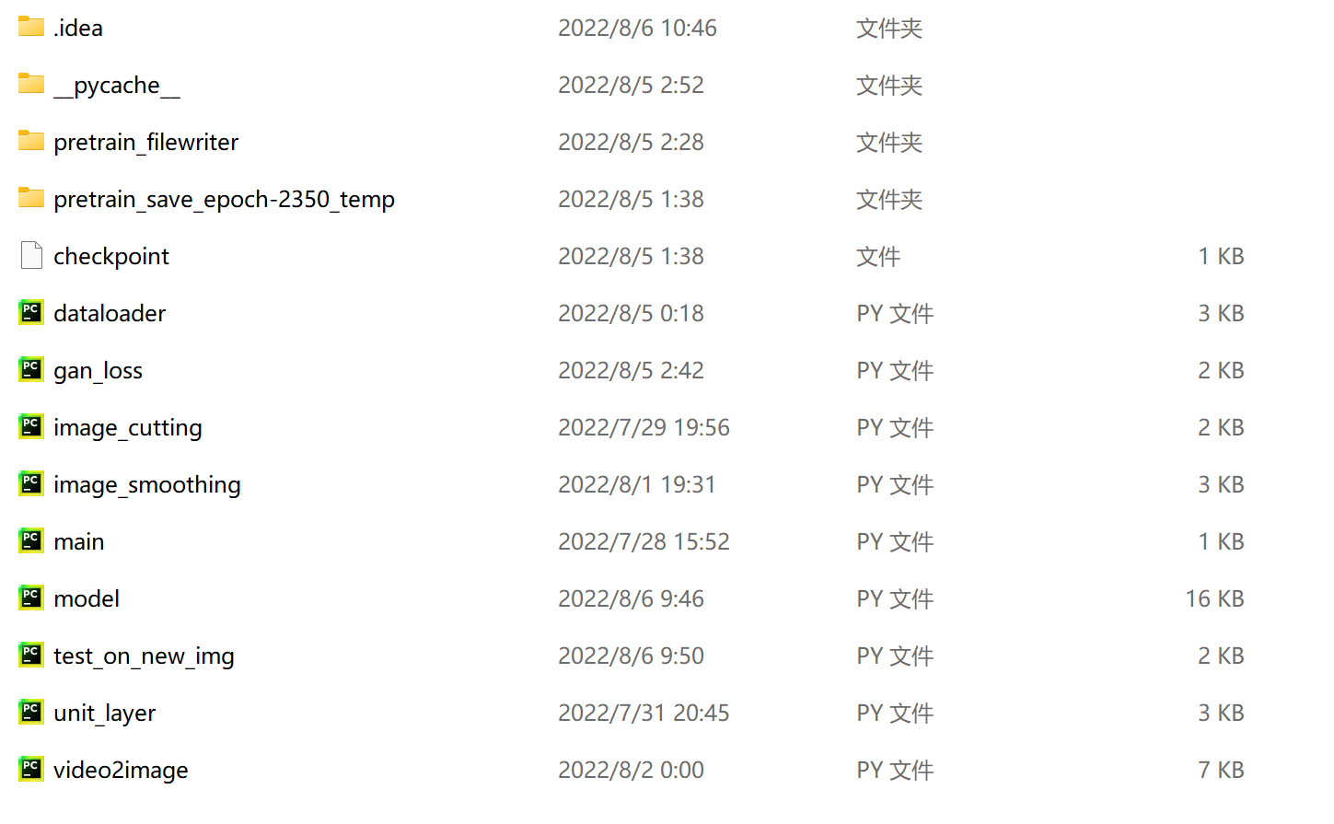
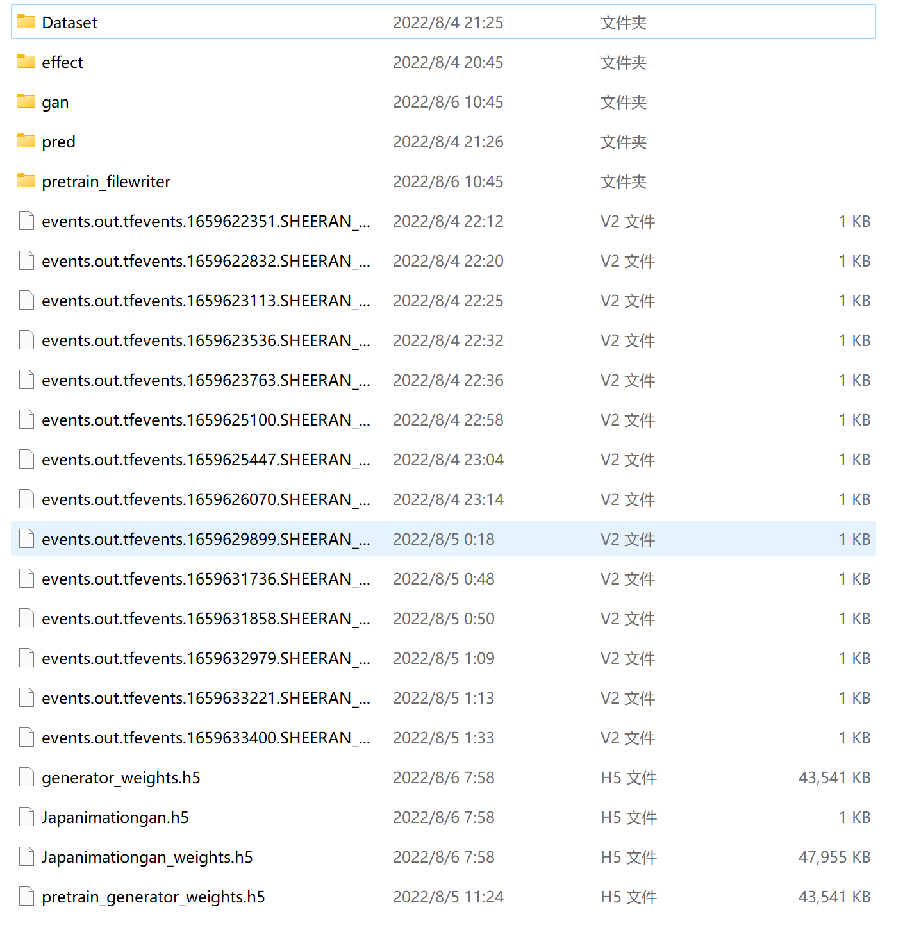
Tutorial

Slide 9
Prepare your working environment. My working environment is listed below:
Hardware environment
·Dell Inspiron 16 7610, 16GB RAM, 512GB storage
·64-bit operating system, x64-based processor
·CPU 11th Gen Intel(R) Core(TM) i7-11800H @ 2.30GHz 2.30 GHz
·GPU NVIDIA GeForce RTX 3060 Mobile 6GB GDDR6
Software environment
·Win 11 operating system
·V11.2.152 Cuda
·V8.2.0 cuDNN
·2.8.0 tensorflow-gpu
·2.8.0 keras
Cuda, cuDNN installation packages are downloaded from the official website and installed in the local environment. Tensorflow GPU version and keras are installed in the command line window under Anaconda. Specifically, in https://developer.nvidia.com/cuda-toolkit-archive, you can get desired Cuda version. In https://developer.nvidia.com/rdp/cudnn-archive, you can get desired CuDNN version. For tensorflow, use ‘pip install tensorflow -gpu==2.8.0’ to download it. For keras, currently(2022.8) you can simply use ‘pip install keras’. Specify keras version according to your need.
Download all my codes and the supporting training dataset. The functions of each Python file in the folder are as follows:
dataloader: The function in it is imported and used in ‘model’ file to build an iterator, which generate a batch of file address of the pictures each time. Training phase requires such kind of data loader.
gan_loss: The functions in it define loss functions for optimizing GAN model, including generator loss, discriminator loss for general GAN model, and content loss, style loss for our specific style transfer task.
unit_layer: The functions in it define unit structure for our JanpanimationGAN model
video2image: This file can be used to convert a video to many images. This program is not written by me. I use this tool provided by others to convert videos into many pictures to build my data set. This method is realized by extracting video key frames. The author and source of the program have been marked in the python file.
image_cutting: This program is used to crop pictures extracted from video. Since the size of the original pictures are too large, the program will randomly cut out 6 pictures in the six areas divided in each picture. After running this program, we will get a set of RGB images, all of which have the size of 256×256.
Image_smoothing: Smooth edges of anime images, in order to let the model learn features of this kind of images better.
model: The main part of this project. The program includes the code of Gan model construction and training.
test_on_new_img: Use the trained model to realize animation style conversion on your own images.
(Optional) Build your own dataset: By using ‘video2image’ and ‘image_cutting’ programs mentioned above, you can converted your videos into suitable datasets. To do this, open each file and change video file address and new data set storage address mentioned in these two files. Note that you may have to manually delete some training images, if you build your dataset in this way. This is because some images in the dataset may be basically the same, and some images might be worthless for training the model. After that, run ‘image_smoothing’ program to get smoothed anime images as dataset.
If you want to achieve better effects, train the GAN model for several epochs. Adjust the file directory specified when reading the data set in the "model" program, specify the storage directory of model parameters and prediction results, and run the "train" program. According to your needs, you can freely set the training epoch. It is suggested to run pretraining process for 2 epochs, and run training process for 150 epochs and above.
Put the image you want to achieve style conversion into the / Pretrain / origin directory. After specifying the storage directory of the new file, run the program named "test_on_new_img" to achieve style transfer.

Slide 10
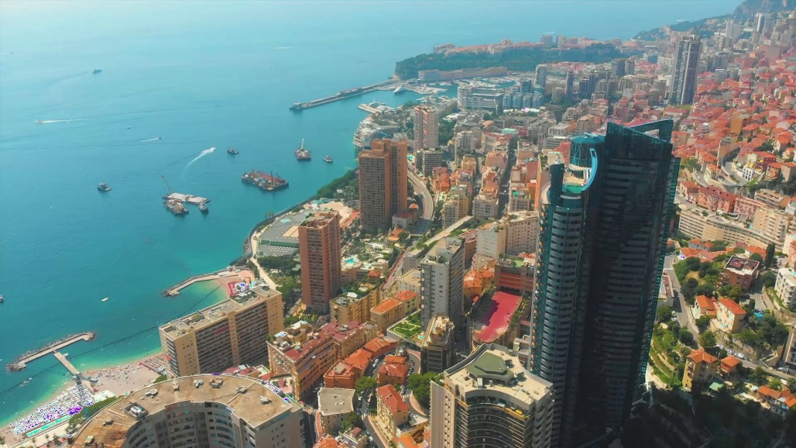
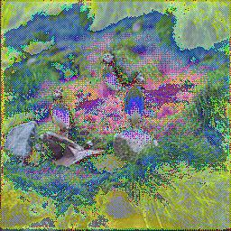
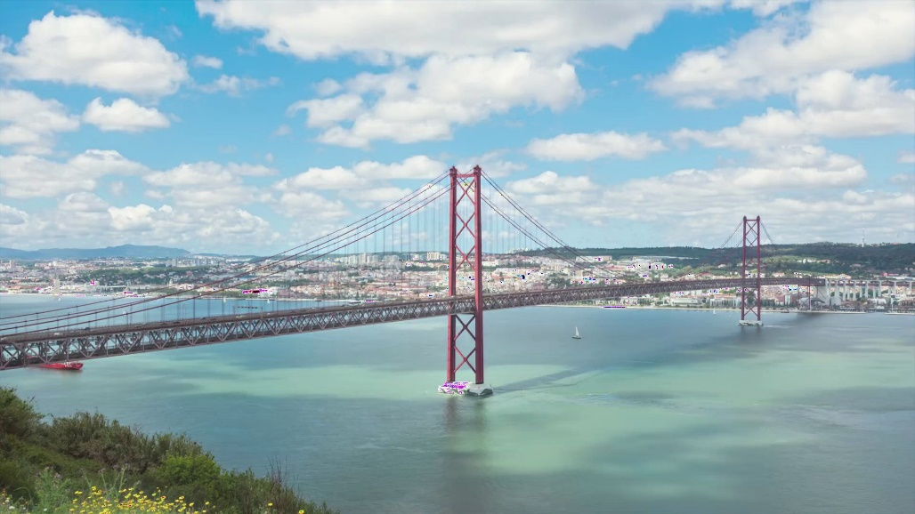
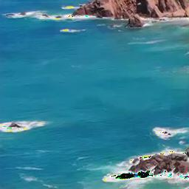
Result

Slide 11
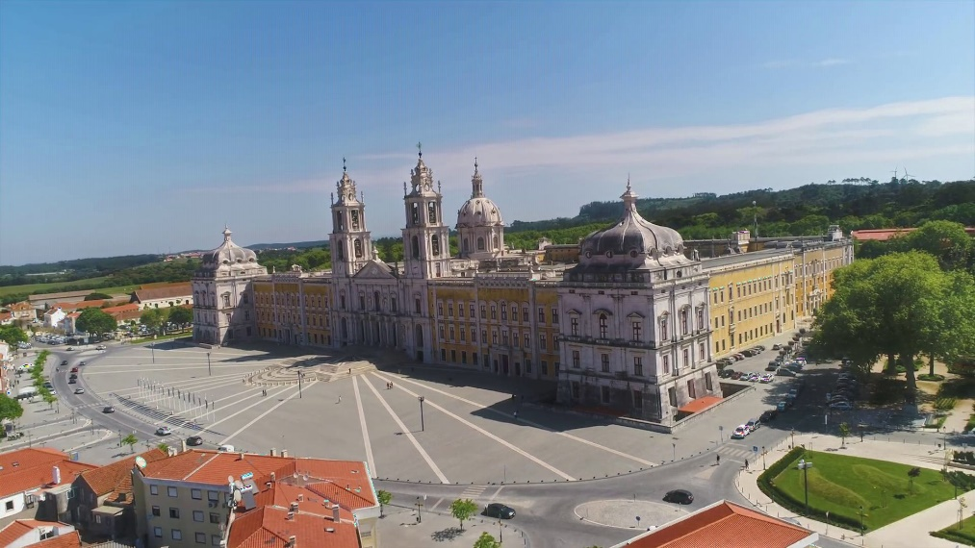
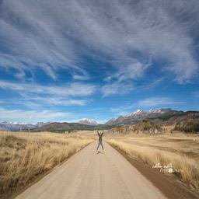
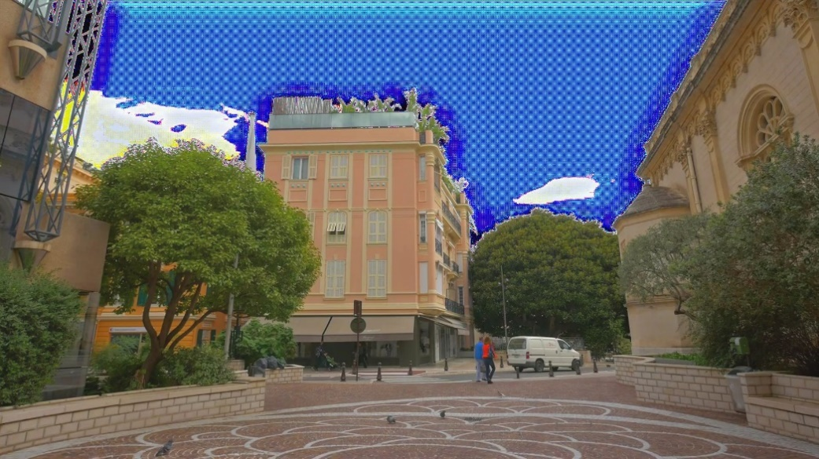
Inadequacies

Slide 12
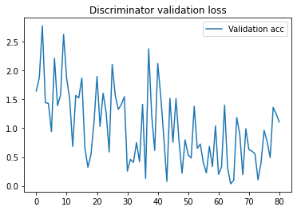
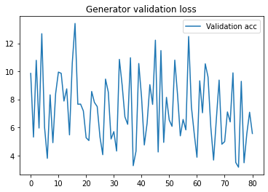
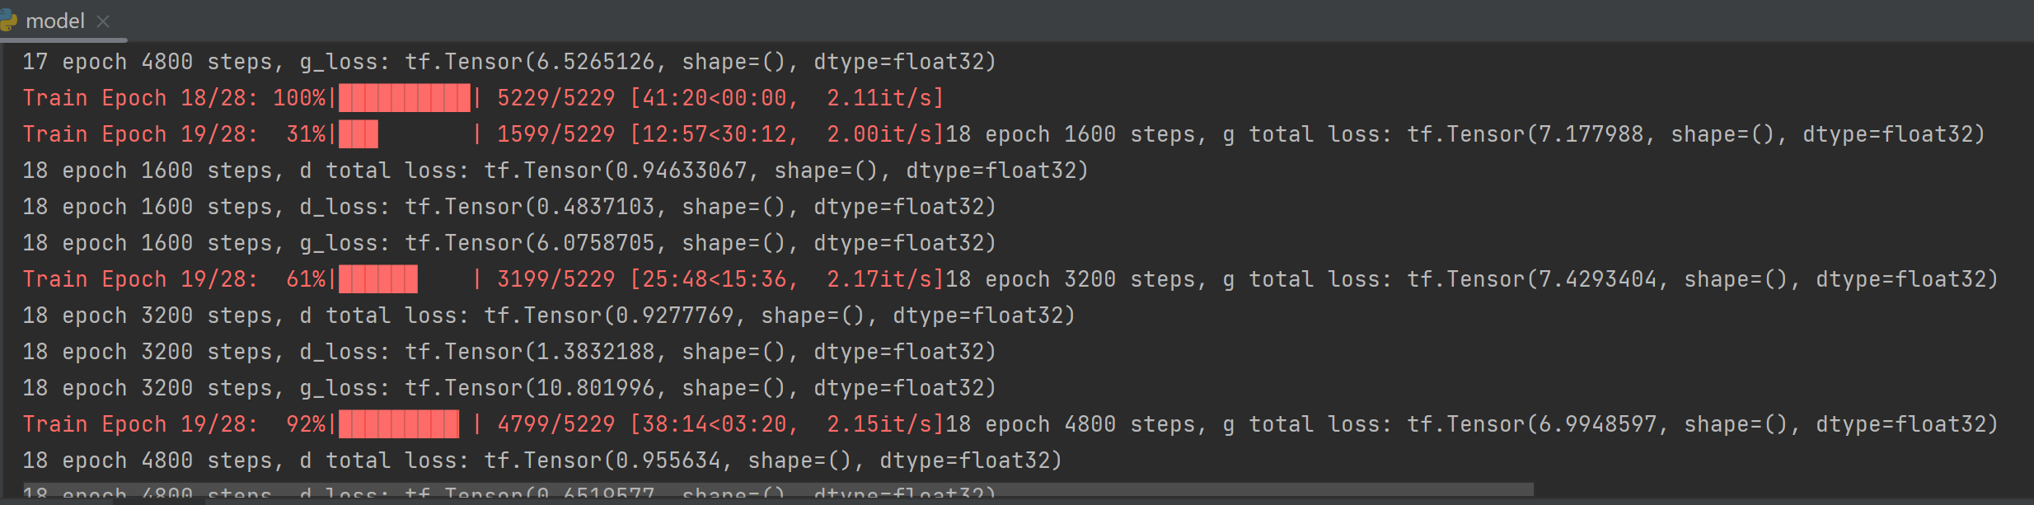

Slide 13
YouTube Video Presentation
YouTube video presentation:
https://www.youtube.com/channel/UCDEljfJMis4aM13ZtzEi_AA
Or you can see this video on my homepage: Username: Sheeran

